Slide 1
Cryptocurrency algorithmic trading
Tyrone Hunt
July 2018

Slide 2
The challenge…
How can I improve my cryptocurrency trading ROI?
Scope
Bitcoin only, testing with a 4 hour time frame
Algorithms
Understand which trading signals are predictive and which machine learning algorithms are most profitable
Automation
Connect the algorithms to a trading bot and scale
Baseline
Create a consolidated view of trading history and calculate existing ROI (including visualization)

Slide 3
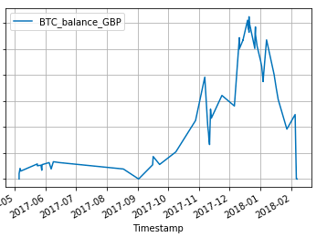
Progress - baseline
Baseline
Create a consolidated view of trading history and calculate existing ROI (including visualization)
Ecosystem Cash Flows
Complexity of cashflows means to get a true baseline ROI, you would need to convert all flows (at time of transfer) to £
£ or €
Coinbase
GDAX
People
BTC
BTC
Initial scope was to build an ETL process to consolidate two exchanges (Coinbase / GDAX) – and plot BTC account balance over time
BANK
ETH
Alt-
coins
LTC
Balance - £

Slide 4
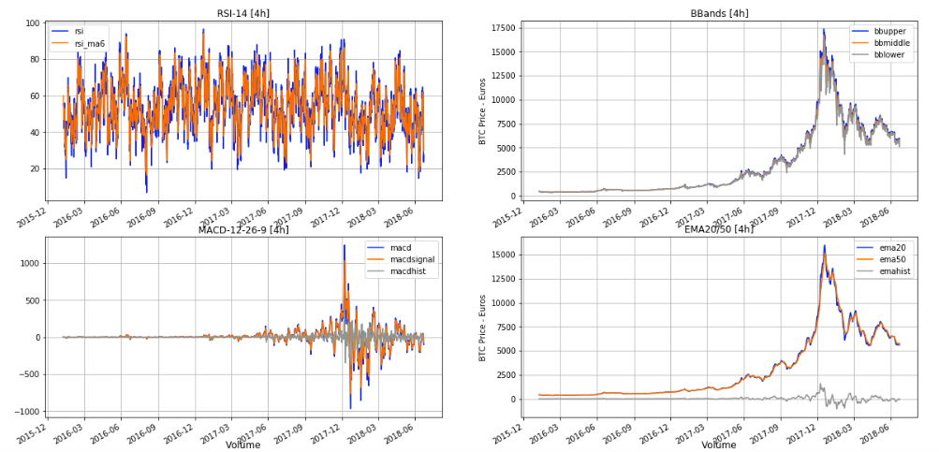
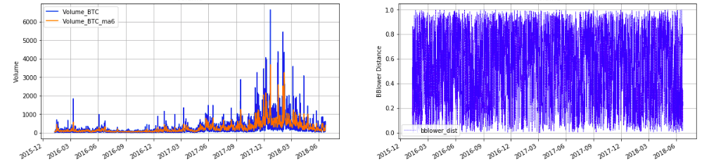
Progress – algorithms used
Algorithms
Understand which trading signals are predictive and which machine learning algorithms are most profitable
Non-algorithmic models
HODL (hold on for dear life) – buy once and do nothing else
RANDOM – every 4 hours randomly buy or sell
RSI (70/30) – relative strength index (buy when oversold, sell when overbought)
Features used
Volume
Price
Bollinger Band Distance
% change from previous day
Momentum
Exponential moving averages
MACD
RSI
Algorithmic models explored
Random Forest
K Nearest Neighbors

Slide 5
Progress – algorithms results
Algorithms
Understand which trading signals are predictive and which machine learning algorithms are most profitable
K Nearest Neighbors - Better at buying (just!)
Random Forest – Better at selling
Predictions
Predictions
Actual Outcome
Actual Outcome

Slide 6
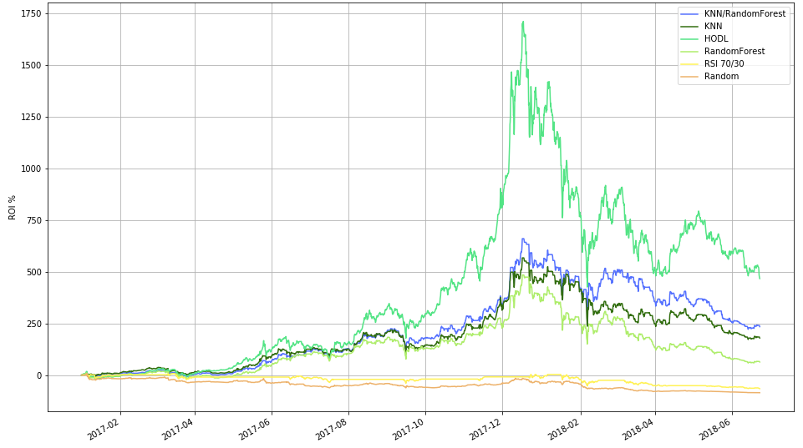
Progress – Simulation results – 18months
Algorithms can’t predict mass hysteria
They do significantly better than other baselines

Slide 7
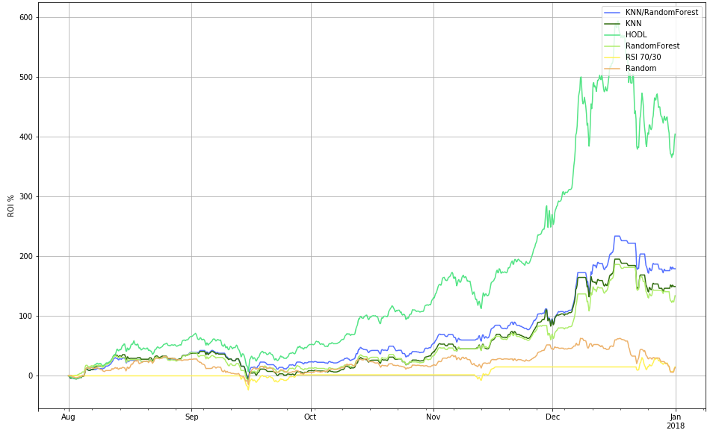
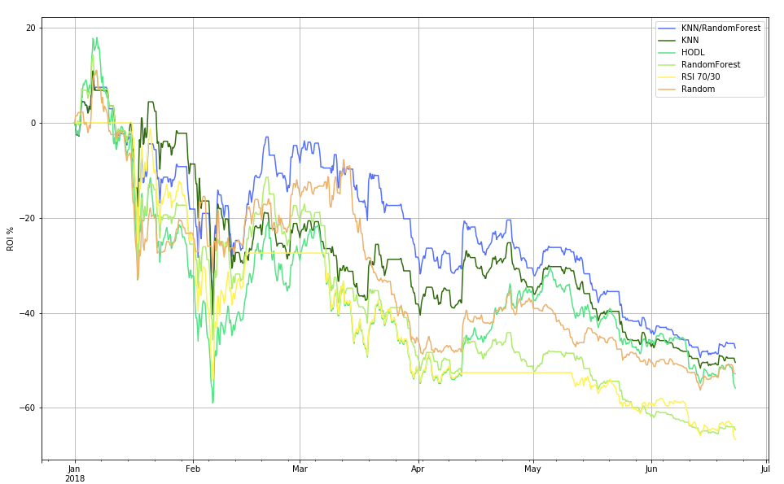


Progress – Simulation results – 12months
As before – algorithms performed less well than HODL in a bull market
Algorithms lost less money in a bear market

Slide 8
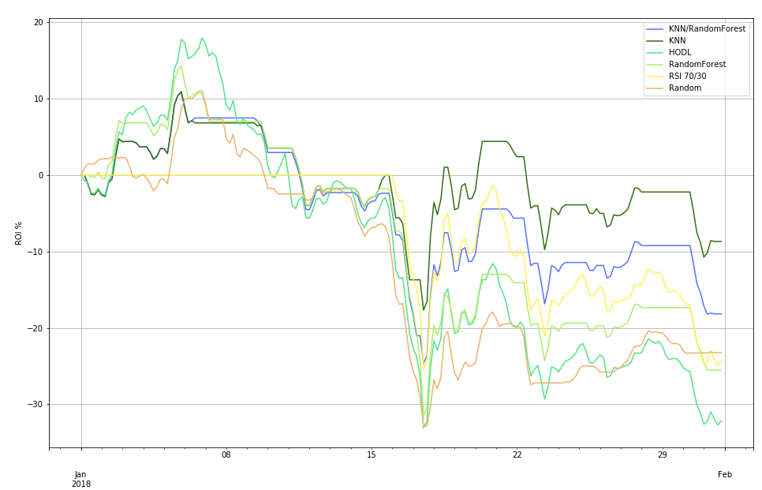
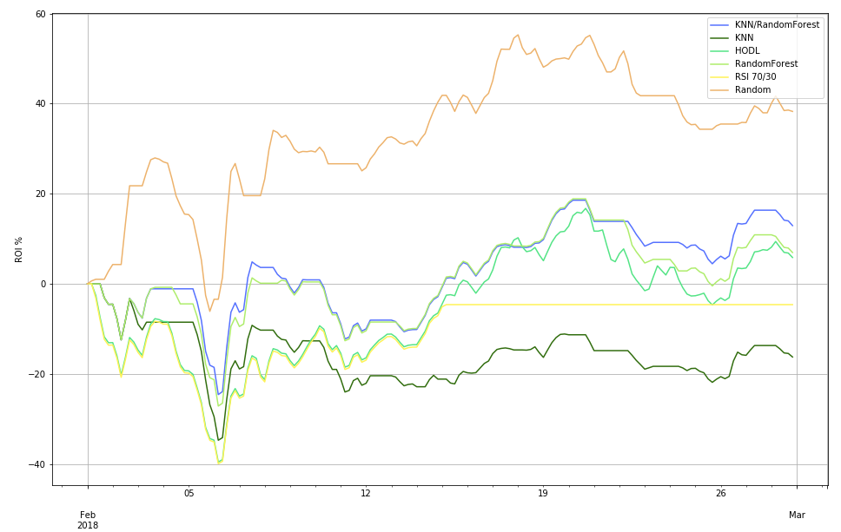
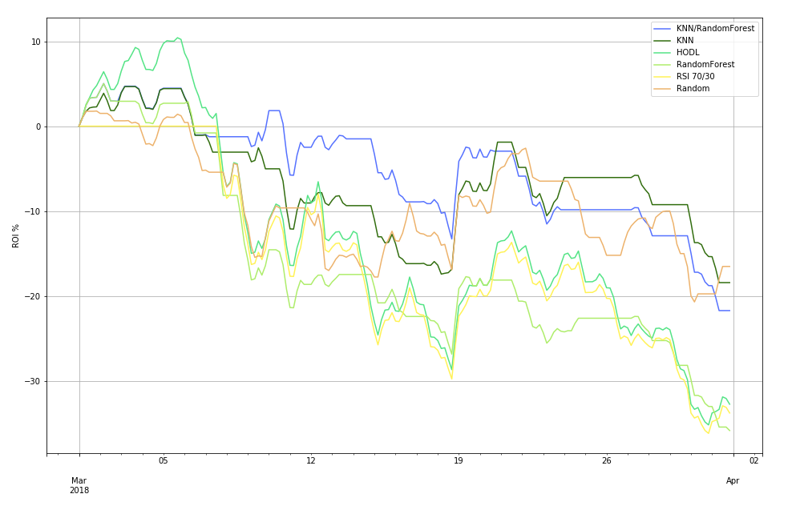
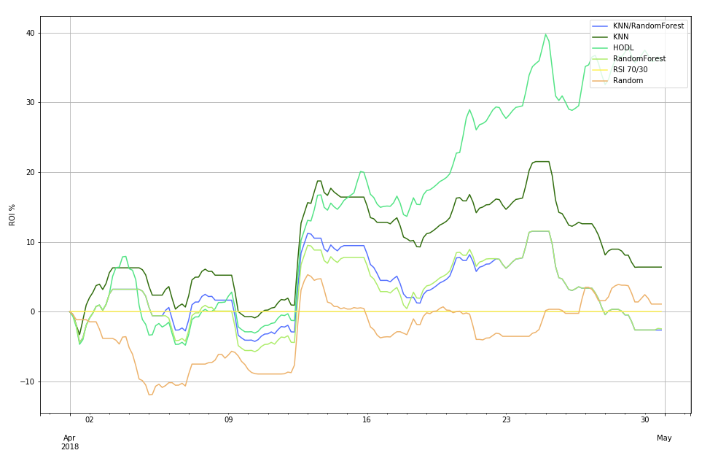
Progress – Simulation results – 1 month
Jan 2018
Feb 2018
Random can sometimes do really well!
Mar 2018
Apr 2018
Short term rallies – HODL is better

Slide 9
Next steps
How can I improve my cryptocurrency trading ROI?
Uncertainty
Scope
Try other timeframes (1 day and 1 week)
Algorithms
Try additional features, tune existing models further
Automation
Connect the algorithms to a trading bot and scale
Baseline
Calculate ROI on individual trades to enable an understanding of trading success
Try time series models
Attempt to predict from model probabilities and/or introduce buy/sell thresholds
Investigate if ‘shorting’ is possible with algorithmic trading
Low
Medium
High
Very High

Slide 10
Technical report

Slide 11
Data processes
Prepare baseline
Prepare price data
Machine Learning Models
Simulate ROI from models
File Name: crypto_transactions.ipynb
Data Source: http://api.bitcoincharts.com/v1/csv
Coinbase.com
File Purpose: ETL process for Coinbase/GDAX
Functions:
unix_to_datetime – converts unix column from data source coinbase_load – loads raw data from coinbase get_coin_prices – merges coinbase data with BTC prices
get_fiat_currencies – gets £/$/Euro
smoother_function & smoother_function_part2 – removes transfers between GDAX /Coinbase
File Name: prepare_trade_data.py
Data Source: http://api.bitcoincharts.com/v1/csv
File Purpose: takes raw BTC price data, cleans it and extracts in OHLC format (candlestick format)
Functions:
unix_to_datetime – converts unix column from data source to datetime
File Name: crypto_significance.ipynb
Data Source: csv output from previous process
File Purpose: creates indicators for BTC price data and then uses KNN and RandomForest categorisation machine learning algorithms to attempt to test if a single moment in time is a buy or sell opportunity
Packages required:
Talib – trading signals generation
statsmodels.graphics.tsaplots – tests for stationarity for models
Plotly – dynamic candlestick plots
File Name: crypto_simulation_4h.ipynb
Data Source: csv output from previous process
File Purpose: trades every 4 hours based on the predictions of the models created previously – returns ROI
Functions:
reset_wallet – creates a blank wallet for the user
buy – buys an amount of BTC at time t
sell – sells and amount of BTC at time t
simulate – switches between buy/sell functions based on model predictions
get_model_value – calculates ROI

